Slide 1
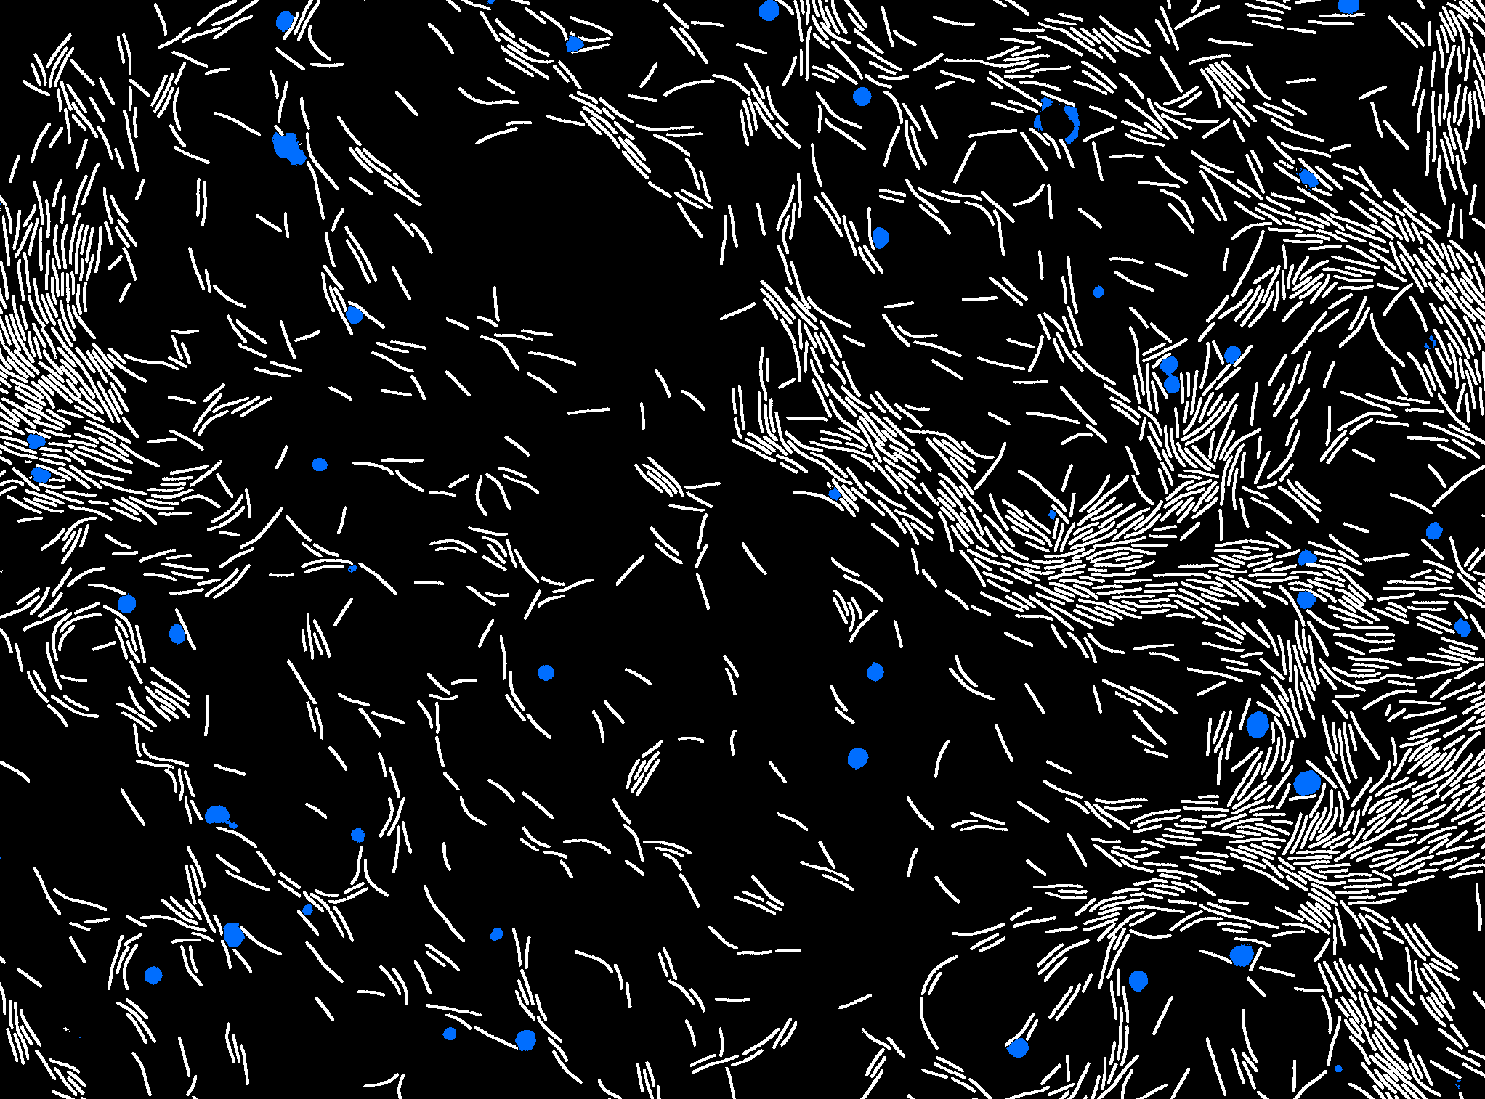
Deep Learning for beginners
Part I - Fundamentals
JB Fiche, CBS-Montpellier & Plateforme MARS-MRI
Francesco Pedaci, CBS-Montpellier
Volker Bäcker, CRBM & MRI
Cédric Hassen-Khodja, CRBM & MRI

Slide 2
End-of-the-day goal
Understand the differences between machine-learning & deep learning
Understand what an Artificial Neuron Network (ANN) is and what are the main parameters to characterize them
What are the fundamentals for building and training an ANN
x₁
b
w₁
x₂
w₂
ϕ
y
w₃
x₃

Slide 3
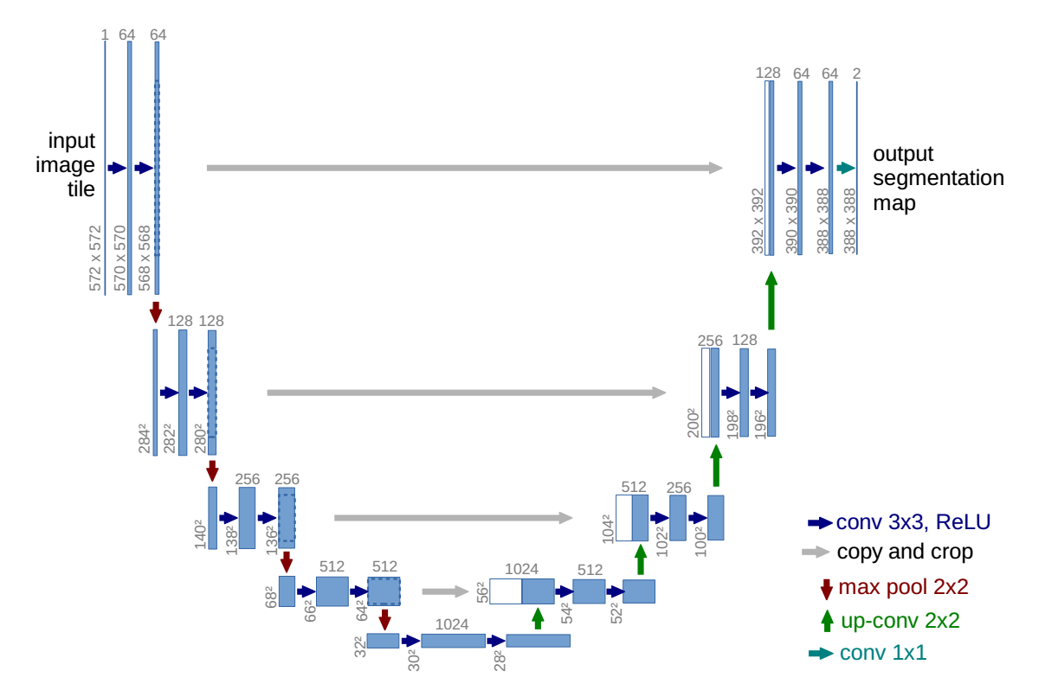
End-of-the-day goal
What is a Convolutional Neural Network (CNN) and why they are useful for image analysis
Have seen a few applications of Deep Learning for image analysis and several of the most common architectures.
Pic Credit: Ronneberger et al. 2015. International Conference on Medical image computing.

Slide 4
Outline
Introduction
Difference between Machine Learning (ML) & Deep Learning (DL)
Brief historical overview
Applications for image analysis
When using DL and which tools are available?

Slide 5
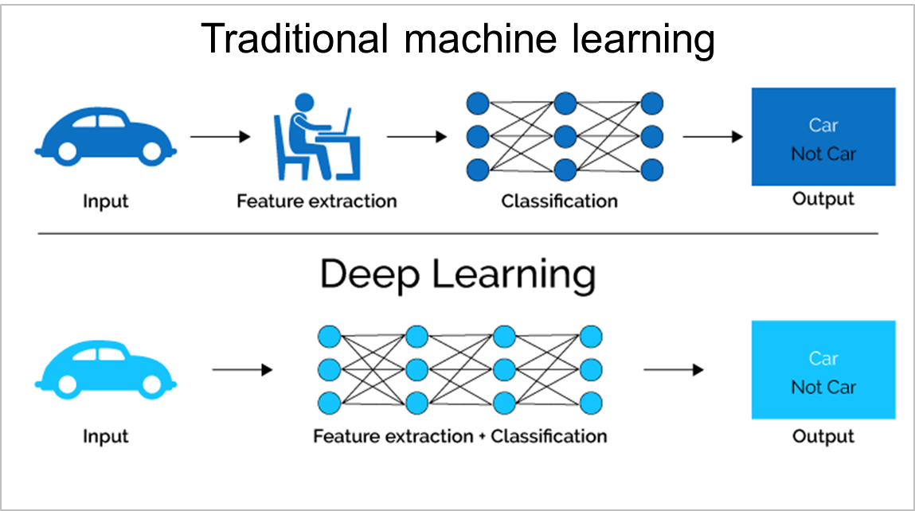
Machine Learning vs. Deep Learning
AI
ML
NN
DL
AI = artificial intelligence
ML = machine learning
NN = neural network
DL = deep learning
Pic Credit: Xenonstack | Machine Learning vs Deep Learning
Machine Learning algorithms are searching for a useful representations of the input data.
Notes:
A machine learning model transforms its input data into meaningful outputs, a process that is « learned » from exposure to known example ofr inputs and outputs. Therefore, the central problem in machine learning (and consequently to deep learning) is to find the way to transform the data in a meaningful way and learn useful representations of the data in order to properly answer the questions at hand.
Machine learning is searching for useful representations of some input data within a predefined space of possibilities (or in other words, a predefined set of features extraction filters), using guidance from a feedback signal. For deep learning, the features are not learned from a pre-defined library of filters but are directly learn by the network. Therefore, a Deep Learning algorithm is looking for a useful representation of the input data using ONLY a feedback signal.

Slide 6
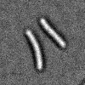

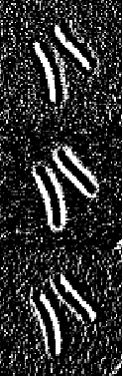

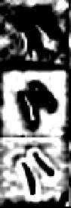
Deep Learning : why “Deep” ?
Input data
Prediction
For each layer, new representations of the input data are learnt and used to perform a specific task.
The « Deep » in Deep Learning is a reference to the successive layers of representations the network is using to perform its task.
Notes:
The deep in deep learning is not a reference to a deeper/better understanding of the data but rather a reference to the layer-by-layer architecure of the network. Each layer will learn specific representations of the data. The deeper you go into the netwrok, the more complicated and sophisticated the representations of the input data are.

Slide 7
Supervised Deep Learning : what “training” means?
Ground truth
Known “raw” data
+
-
Model
Feedback
During the training, the network will learn how to represent the data in a useful way in order to perform a specific task (segmentation, denoising, etc.)
Notes:
The deep in deep learning is not a reference to a deeper/better understanding of the data but rather a reference to the layer-by-layer architecure of the network. Each layer will learn specific representations of the data. The deeper you go into the netwrok, the more complicated and sophisticated the representations of the input data are.

Slide 8

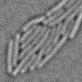
Supervised Deep Learning : what “training” means?
Training set :
Trained model
Validation/testing
sets :
Prediction
95,6%

Slide 9
Outline
Introduction
Difference between Machine Learning (ML) & Deep Learning (DL)
Brief historical overview
Applications for image analysis
When using DL and which tools are available?

Slide 10
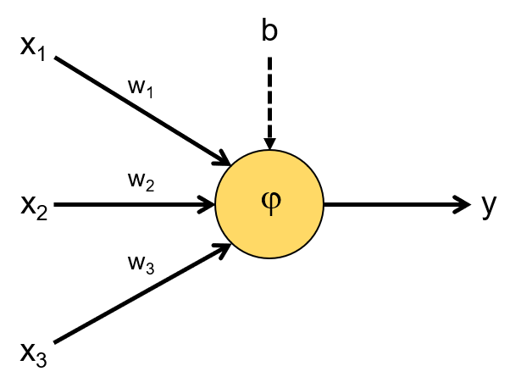
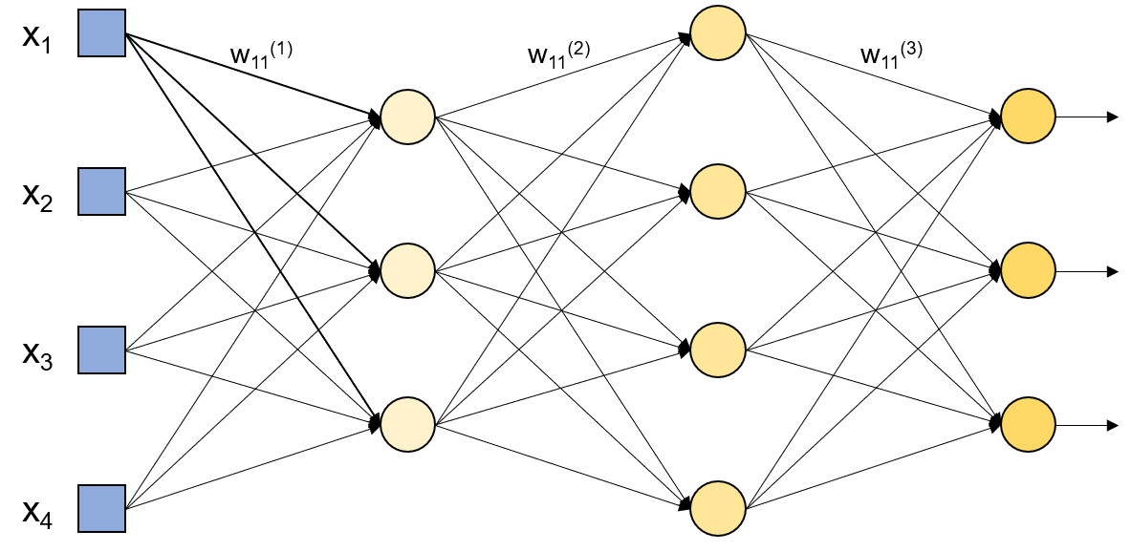
Brief historical overview
40s-60s
80s-90s
Cybernetics : linear neural network models able to handle simple classification tasks
Connectivism : Development of the back-propagation algorithm for the training of deep neural network. First convolutional network.

Slide 11
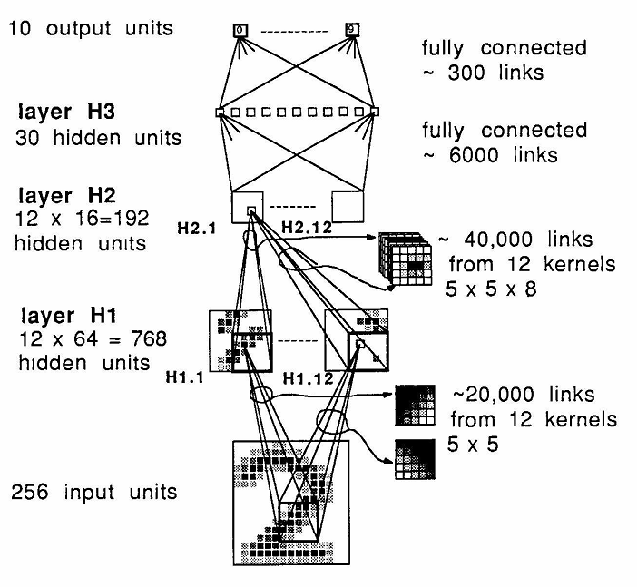
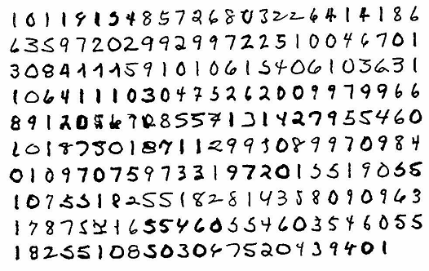
Hand-written zipcode classification - 1989
Deep learning models were already successfully used in the 90’s for complicated tasks such as hand-written digit classification.
The same algorithms are still used nowadays for image analysis.
Pic Credit: LeCun et al. 1989. Neural Computation

Slide 12

Brief historical overview
40s-60s
80s-90s
2012
Cybernetics : linear neural network models able to handle simple classification tasks
Connectivism : Development of the back-propagation algorithm for the training of deep neural network. First convolutional network.
First time a Deep Learning convolutional algorithm wins the ImageNet competition

Slide 13
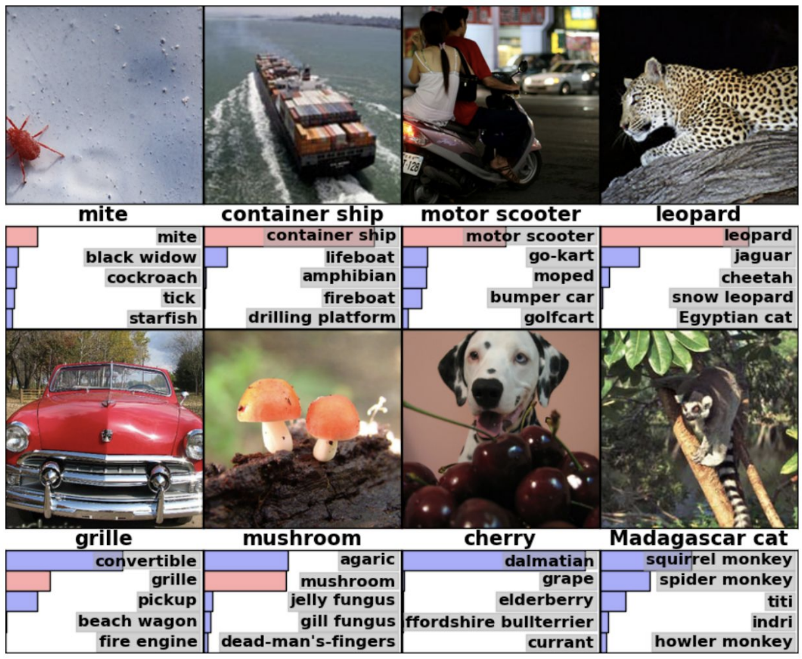
2012 : Breakthrough for image classification
The Image Large Scale Visual Recognition Challenge started in 2010 using the ImageNet database (15M labelled images and 22,000 different object categories).
Notes:
For the competition, ~1000 images were used for a 1000 categories. 1,2M of images for the training, 50,000 for validation and 150000 for testing
In 2010, the ILSVRC competition – Image Large Scale Visual Recognition Challenge – started. The goal of this competition is to estimate the content of photographs for the purpose of retrieval and automatic annotation using a subset of the large hand-labeled ImageNet dataset (10,000,000 labeled images depicting 10,000+ object categories) as training. Test images (200,000 images from flikr) will be presented with no initial annotation -- no segmentation or labels -- and algorithms will have to produce labelings specifying what objects are present in the images. In this initial version of the competition, the goal is only to identify the main objects present in images, not to specify the location of objects.

Slide 14
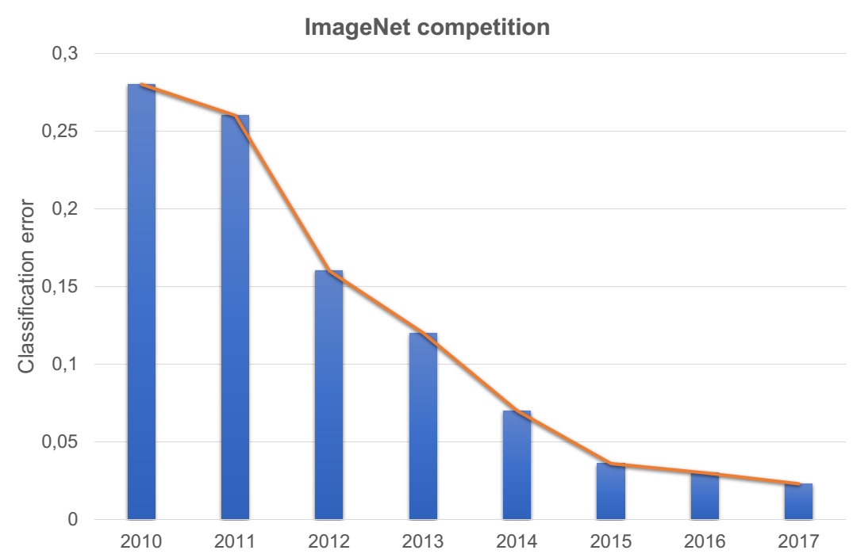
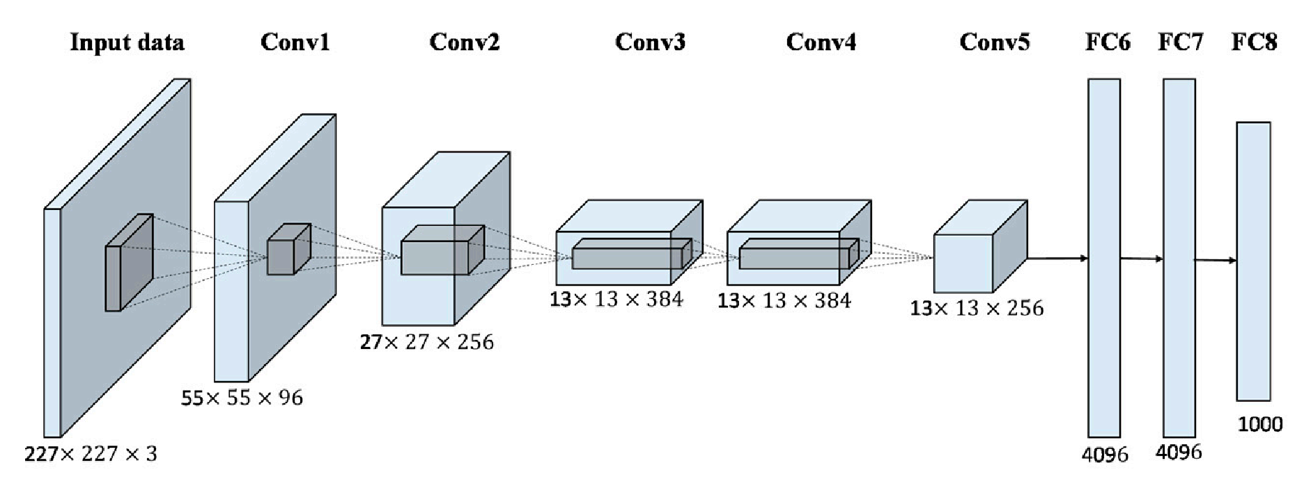
2012 : Breakthrough for image classification
AlexNet : Convolutional Neural Network (CNN)
Pic Credit: Han et al. 2017. Remote sensing.
Human error
Features engineering
Deep Learning
Krizhevsky et al. 2012. Advances in neural information processing systems
Notes:
AlexNet – 9 layers -> 60 M of parameters needed to be trained.

Slide 15
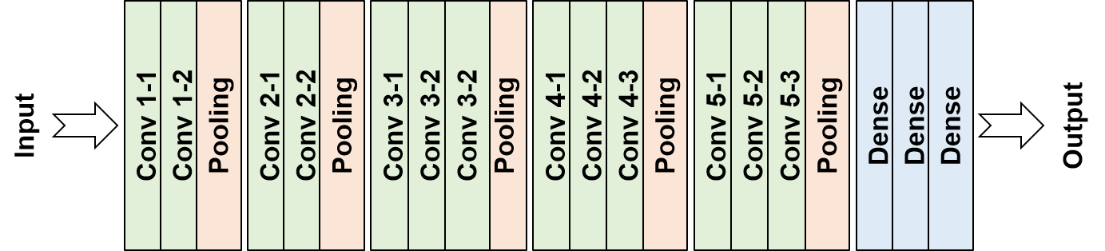
2012 : Breakthrough for image classification
VGGnet : Convolutional Neural Network (CNN)
Human error
Features engineering
Deep Learning
Simonyan & Zisserman. 2015. Internantional conference on learning representations
Notes:
VGG 16 & 19 : freely available pre-trained network that could be used for image classification -> >138M of parameters.

Slide 16
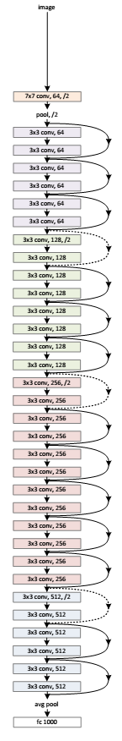
2012 : Breakthrough for image classification
ResNet : Deep residual learning - microsoft
Human error
Features engineering
Deep Learning
Pic Credit: He et al. 2016. Conference on Computer Vision and Pattern Recognition
Notes:
-> 25M of parametes, more than one order of magnitude below the VGG16. New architecture are therefore lighter, less deep, and as efficient as the sequential models.

Slide 17
Why only now?
?
40s-60s
80s-90s
2012
Cybernetics : linear neural network models able to handle simple classification tasks
Connectivism : Development of the back-propagation algorithm for the training of deep neural network. First convolutional network.
First time a Deep Learning convolutional algorithm wins the ImageNet competition

Slide 18
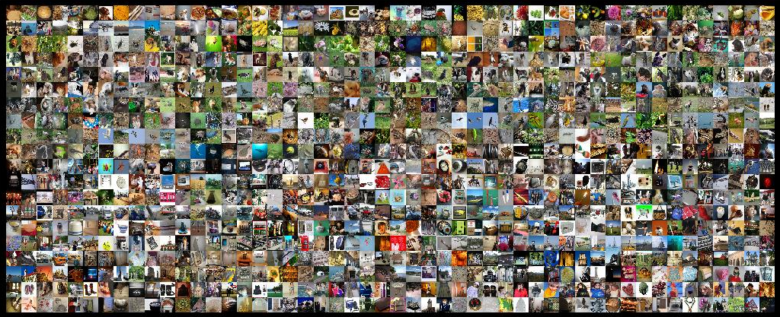
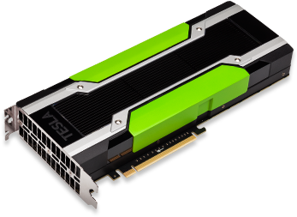
Why only now?
?
80s-90s
2012
1- Internet : offers a huge source of high-resolution annotated images, essential for an efficient training.
2- Computer resources : faster CPU and GPU, able to perform >10¹² operations/s
NVIDIA TESLA
>3000€
3- New algorithms : activation function (ReLu), faster optimizers, methods to avoid overfitting (Dropout), etc.
Notes:
Voir Le bouquin Deep Learning pour plus d’infos regarding the number of images available and the informations available + missing a third important point : improvement of the training algorithm (relu, optimizer, etc…). Need to change the slide

Slide 19
Outline
Introduction
Difference between Machine Learning (ML) & Deep Learning (DL)
Brief historical overview
Applications for image analysis
When using DL and which tools are available?

Slide 20
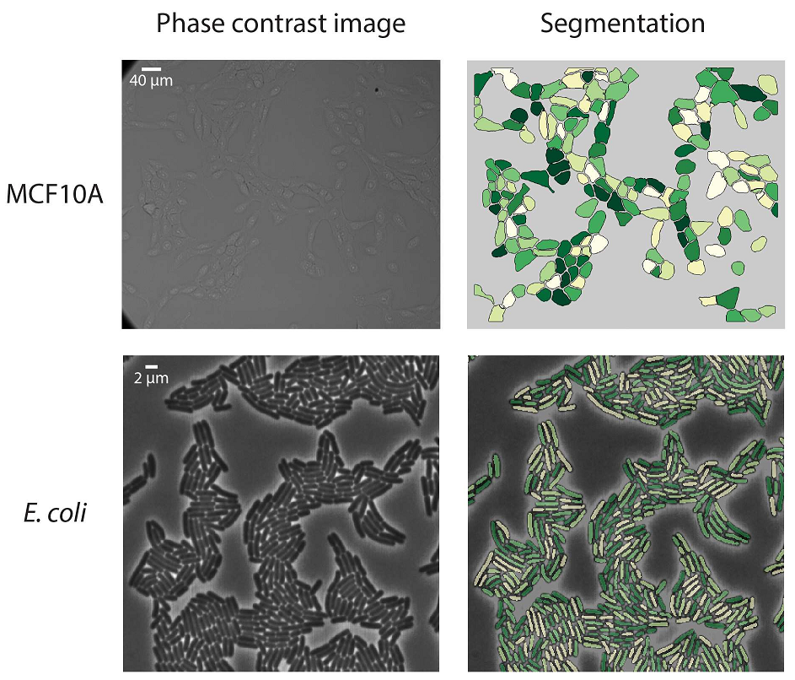
Deep Learning applications : a few examples
Segmentation
Pic credit : Van Valen et al. 2016. Plos Computational Biology

Slide 21
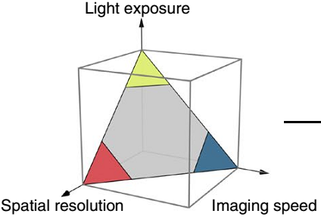
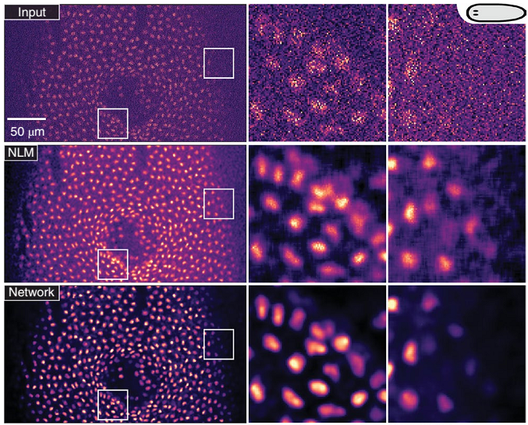
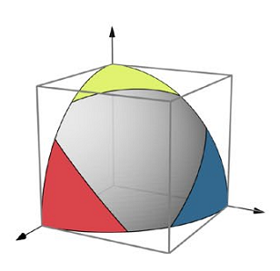
Deep Learning applications : a few examples
Segmentation
Image restoration
Nucleus stained of S. meditarranea (RedDot1)
Pic credit : Weigert et al. 2018. Nature Methods – Buades et al. 2005. Conference on Computer Vision and Pattern Recognition
Notes:
NLM – Non local mean denoising algorithm.
Network is called CARE

Slide 22
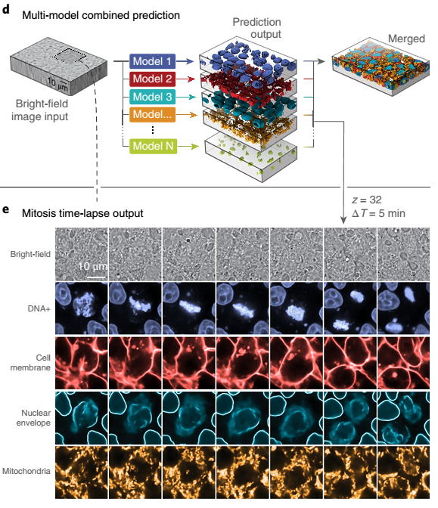
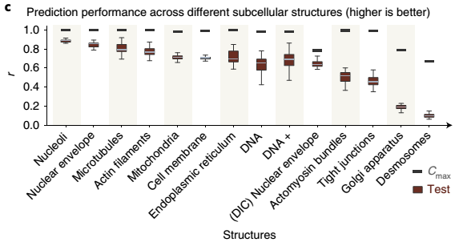
Deep Learning applications : a few examples
Segmentation
Image restoration
Image prediction
Pic credit : Ounkomol – 2018. Nature Methods

Slide 23
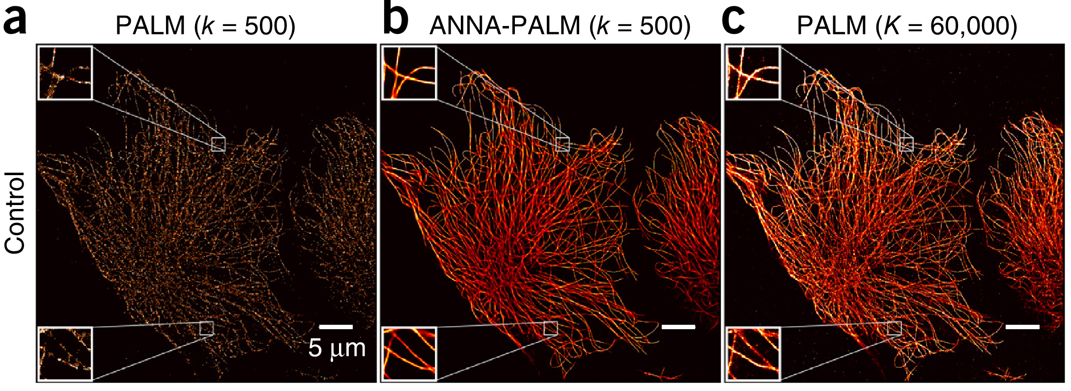
Deep Learning applications : a few examples
Segmentation
Image restoration
Image prediction
Super-resolution prediction
Pic credit : Ouyang – 2018. Nature Biotechnology

Slide 24
Outline
Introduction
Difference between Machine Learning (ML) & Deep Learning (DL)
Brief historical overview
Applications for image analysis
When using DL and which tools are available?

Slide 25
Why using Deep Learning?
When classic image processing/analysis tools are not efficient or do not exist for the task we want to perform (eg. PALM image prediction)
Need to have enough analyzed data to train the network
Need to label the data in order to get database large enough for the training
Time consuming
Network are trained for a specific set of data. New type of data means new training.
Not (always) flexible
Deep Learning needs large computational resources for image analysis
Expensive

Slide 26




Which tools are available for Deep Learning?
Matlab 2018 version and later
Toolkits dedicated for ANN and deep learning.
Python 3 – open source
For DL, the open-source TensorFlow library from Google is used.
imJoy – open source
Plugin developed by the MIT and freely available on GitHub.

Slide 27




Deep Learning with Python
Open source distribution of Python, compatible with Windows, MacOS and Linux.
Spyder and Jupyter Notebook are two python environments available with Anaconda and compatible with TensorFlow

Slide 28
Outline
Introduction
Starting with Deep Learning and Artificial Neuron Network
A bit of vocabulary before starting
Case 1 : single neuron network
Case 2 : how to construct a densely connected network
Case 3 : multi-class clusterization
Summary

Slide 29
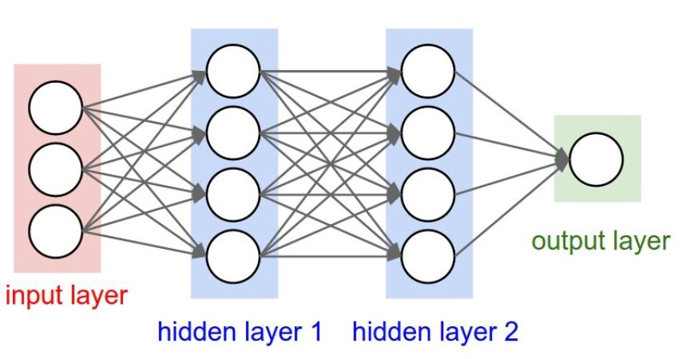
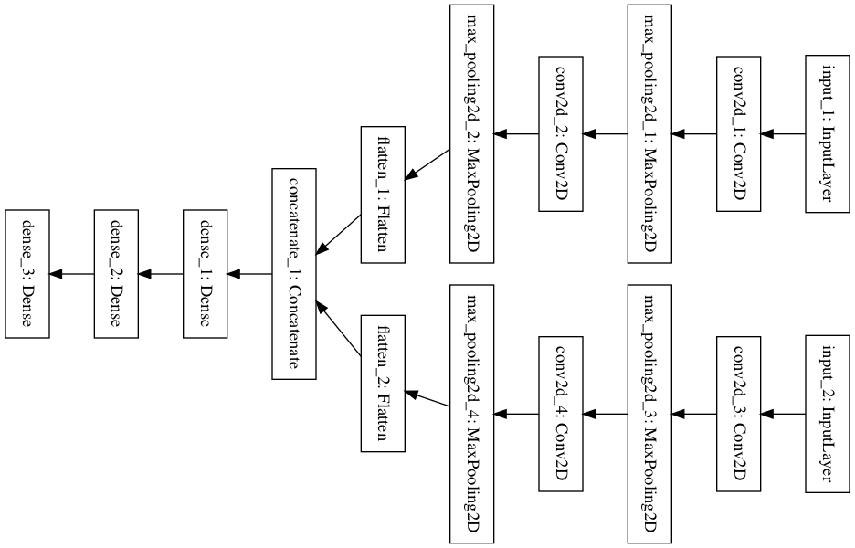
Sequential vs. non-sequential models
Sequential model
Non-sequential model

Slide 30
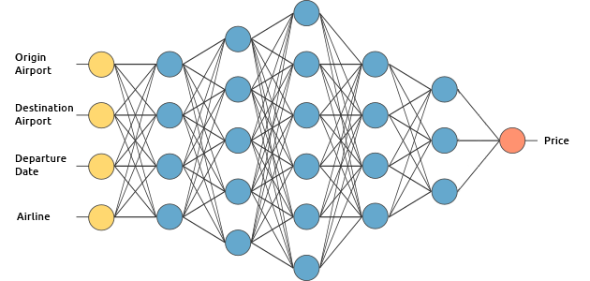
Regression vs. Classification
Regression : output is one or more real numbers
Classification : output is the probability that input belong to one or more classes
1 – 0
Yes – No
Cat - dog
Price
(0 – inf)
prob. Class 1
position X (-inf, inf)
position Y (-inf, inf)
prob. Class 2
position Z (-inf, inf)
prob. Class 3

Slide 31
Training, Testing and validation sets
Training set (70-80%)
Validation
set
Testing
set
1)
2)
Training set
Training
network
Validation set
network
trained
Test set
Validation
Final validation
User makes corrections

Slide 32
Outline
Introduction
Starting with Deep Learning and Artificial Neuron Network
A bit of vocabulary before starting
Case 1 : single neuron network
Case 2 : how to construct a densely connected network
Case 3 : multi-class clusterization
Summary

Slide 33
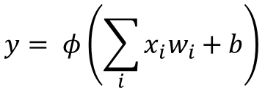
Definition of an artificial neuron
Weights
Bias
= Trainable parameters
&
x₁
w₁
b
$$y= φ\left(\sum_{i}{x_{i}w_{i}}+b\right)$$
x₂
w₂
φ
w₃
x₃
Input
Activation function
Prediction

Slide 34
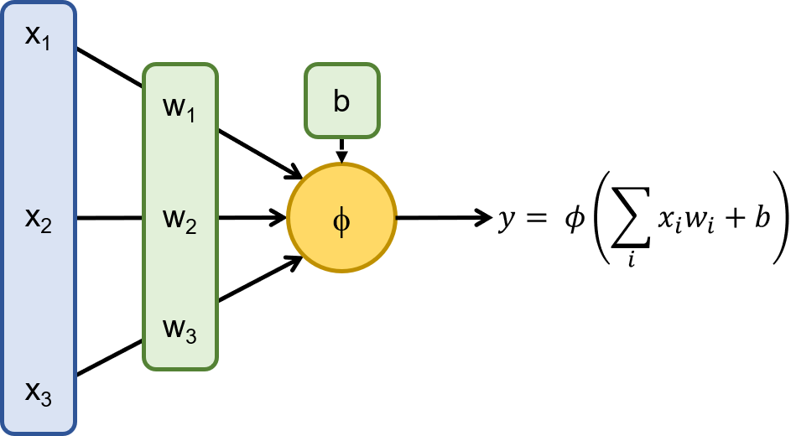
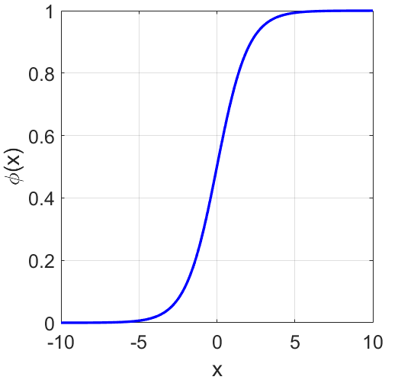
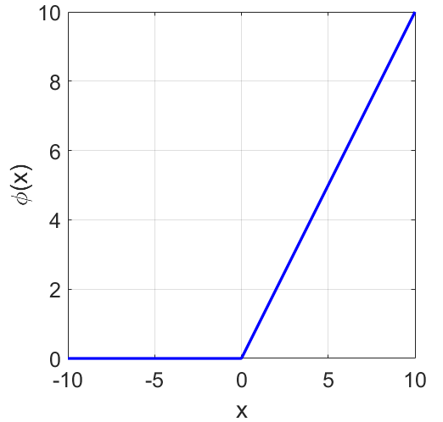
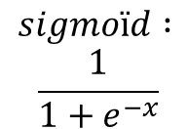
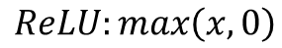
Most common activation functions
$$sigmoïd :$$
$$\frac{1}{1+e^{−x}}$$
$$ReLU:max\left(x,0\right)$$

Slide 35
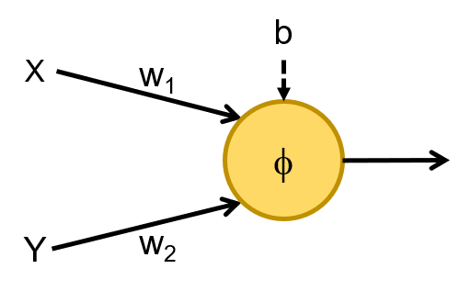
Example 1 : train a simple classifier with one neuron
Example n°1 : Clusterization_linearly_separated.ipynb
Understand the principle of the training
Train the classifier and test its accuracy
First step with Keras/TensorFlow

Slide 36
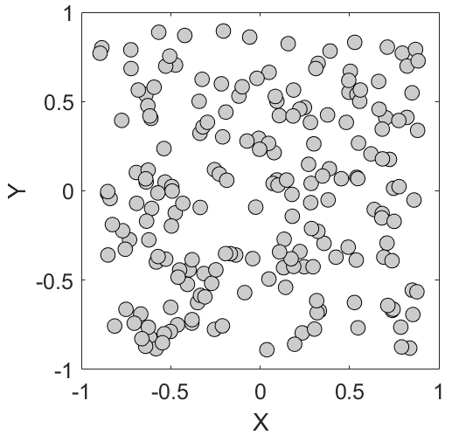
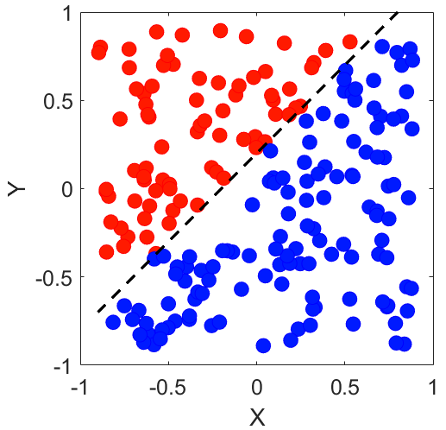


Example 1 : A one neuron classifier
b
_{X}
w₁
φ
w₂
Y
Input data: X,Y coordinates
Goal of the training = find the best set of parameters {w₁, w₂, b} allowing for an accurate clusterization of the input data
Prediction : class red or blue
= 0
= 1

Slide 37
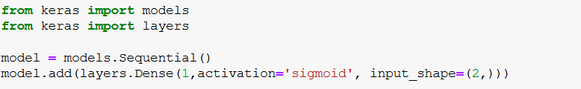
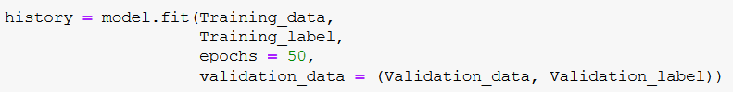
Definition of the classifier with Keras
1- Definition of the network architecture
2- Definition of the training options
3- Training

Slide 38
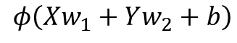
Definition of the classifier with Keras
1- Definition of the network architecture
# of neurons
φ
X,Y
$$φ\left(Xw_{1}+Yw_{2}+b\right)$$

Slide 39
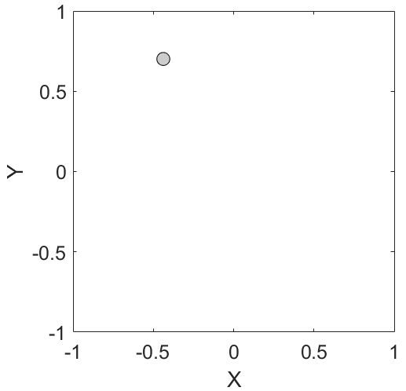
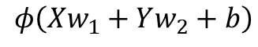
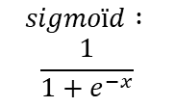
Training : step by step explanation
The sigmoid is chosen as activation function and a “prediction” is calculated
$$φ\left(Xw_{1}+Yw_{2}+b\right)$$
$$sigmoïd :$$
$$\frac{1}{1+e^{−x}}$$
>0,5
The weights are usually randomly initialized and the bias set to zero.
< 0,5
Notes:
Need to translate the “class” into a number for the algorithm being able to process it

Slide 40
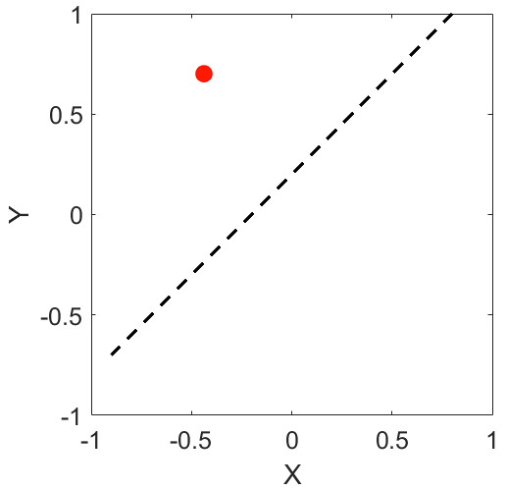
Training : step by step explanation
The loss function is used to measure how far the prediction is from the expected result.
+/-
Loss function
$$φ\left(Xw_{1}+Yw_{2}+b\right)$$
The calculated output from the neuron is compared to the expected result.
Notes:
Need to translate the “class” into a number for the algorithm being able to process it

Slide 41
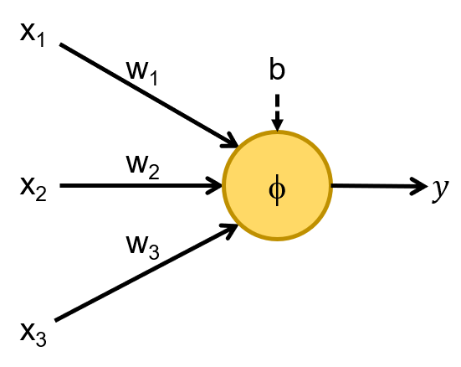
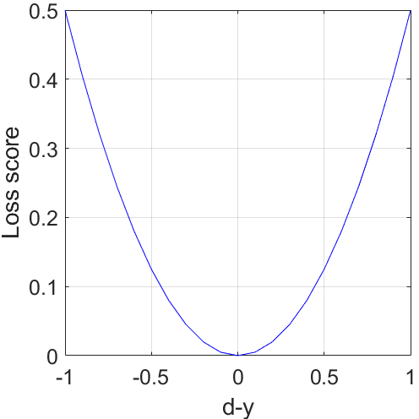
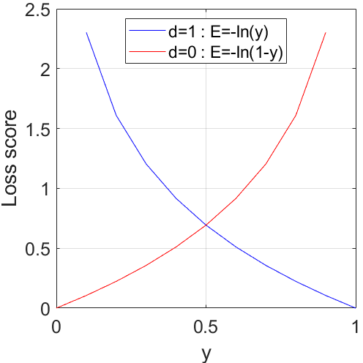
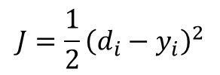
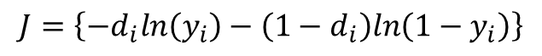
What is the loss function?
$$J=\frac{1}{2}{\left(d_{i}−y_{i}\right)}^{2}$$
$$J=\left\{−d_{i}ln\left(y_{i}\right)−\left({1−d}_{i}\right)ln\left({1−y}_{i}\right)\right\}$$
Squared error function, mainly used for regression problems.
Binary crossed entropy, used in classification problems.
Notes:
Enlever le sigma

Slide 42
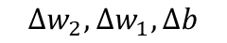
Training : step by step explanation
Optimizer
$${Δw}_{2}, Δw_{1},Δb$$
Loss score
+/-
Loss function
$$φ\left(Xw_{1}+Yw_{2}+b\right)$$
Notes:
Need to translate the “class” into a number for the algorithm being able to process it

Slide 43




Optimizer : single gradient descent SGD
$$∆w_{i}=−α\frac{∂E}{∂w_{i}}$$
α Is the learning rate
Loss score E
i
i+1
i+2
i+3
Wi
Pic credit : https://medium.com/@ramrajchandradevan/the-evolution-of-gradient-descend-optimization-algorithm-4106a6702d39
Notes:
Alpha is the learning rate – important parameter
Here it is in a highly dimensioned system since we have a high number of parameters to adjust. We found a minima within a parameters space containing sometimes millions of dimensions -> the learning rate is a very important parameter!

Slide 44

Training : step by step explanation
2- Definition of the training options
Optimizer
$${Δw}_{2}, Δw_{1},Δb$$
Loss score
+/-
Loss function
Training data
Prediction
Ground truth
Notes:
Need to translate the “class” into a number for the algorithm being able to process it

Slide 45



Training results
3- Training
$${Δw}_{2}, Δw_{1},Δb$$
Training data
Weights correction

Slide 46


Training results
3- Training

Slide 47

Validation of the training using the testing set
Estimation of the model accuracy
Testing data
Global accuracy 98%

Slide 48

What did we learn so far?
How a single neuron works :
Activation function
Input / output
Weights and bias
How the training works :
Loss function
Optimizer
Learning rate
To be defined by the user
$$φ\left(Xw_{1}+Yw_{2}+b\right)$$
Input
weights
Layer #1
weights
Layer #2
…
weights
Layer #n
Δw
Predictions
Ground Truth
Optimizer
Loss function
Loss score

Slide 49
Outline
Introduction
Starting with Deep Learning and Artificial Neuron Network
A bit of vocabulary before starting
Case 1 : single neuron network
Case 2 : how to construct a densely connected network
Case 3 : multi-class clusterization
Summary

Slide 50


Example 2 : classify non-linearly separable data
Example n°2 : Clusterization_not_linearly_separated_parabole
Observe the limitations of single-layer model
Find a simple architecture able to solve this classification problem
X
Y

Slide 51

Example 2 : classify non-linearly separable data
Try to train the classifier with one single neuron :
Repeat the same procedure using more neurons to “fit” the model :
X
Y
Notes:
Try varying the number of input data and the learning rate (default values are 750 and 5e-2) and the number of neurons.

Slide 52
Back-propagation algorithm : a quick glimpse
w₁₁¹
w₁₁²
X
w₁₂¹
w₂₁²
w₁₃¹
w₃₁²
Y
w₄₁²
w₁₄¹
Input
Hidden layer
4 neurons
Output
Total number of trainable parameters : 4*2 + 4 + 4 + 1 = 17

Slide 53
Back-propagation algorithm : a quick glimpse
w₁₁¹
w₁₁²
X
w₁₂¹
w₂₁²
w₁₃¹
w₃₁²
Y
w₄₁²
w₁₄¹
Input
Hidden layer
4 neurons
Output
Forward pass

Slide 54
Back-propagation algorithm : a quick glimpse
w₁₁¹
w₁₁²
X
w₁₂¹
w₂₁²
w₁₃¹
w₃₁²
Y
w₄₁²
w₁₄¹
Input
Hidden layer
4 neurons
Output
Forward pass

Slide 55
Back-propagation algorithm : a quick glimpse
w₁₁¹
Ground truth
w₁₁²
X
w₁₂¹
w₂₁²
+/-
Loss function
w₃₁²
Loss
w₁₃¹
Y
w₄₁²
w₁₄¹
Input
Hidden layer
4 neurons
Output
Forward pass

Slide 56

Back-propagation algorithm : a quick glimpse
w₁₁¹
w₁₁²+δ₁²
X
w₁₂¹
w₂₁² + δ₁²
$$Minimize \frac{∂Loss}{∂W}$$
w₁₃¹
w₃₁² + δ₁²
Y
w₄₁² + δ₁²
w₁₄¹
Input
Hidden layer
4 neurons
Output
Backward pass

Slide 57
Back-propagation algorithm : a quick glimpse
w₁₁²+δ₁¹
w₁₁²+δ₁²
X
w₁₁²+δ₁¹
w₂₁² + δ₁²
$$Minimize \frac{∂Loss}{∂W}$$
w₃₁² + δ₁²
Y
w₄₁² + δ₁²
Input
Hidden layer
4 neurons
Output
Backward pass

Slide 58




The network is learning a “better” representation
X
Y
Notes:
Try varying the number of input data and the learning rate (default values are 750 and 5e-2) and the number of neurons.

Slide 59

ReLU vs. Sigmoid
$$sigmoïd :$$
$$\frac{1}{1+e^{−x}}$$
$$ReLU:max\left(x,0\right)$$
Rectified Linear Unit
20 epochs
20 epochs
~90% accuracy
~96% accuracy
Gradient is saturating for large output values and exp() is a computer-expensive operation
Non-saturating gradient and very fast operation. However, negative values are discarded.
Notes:
Exponential function is expensive computational wise

Slide 60



Batch processing
The weights are adjusted N times per epoch
For each training data the weights are adjusted
$$Δw_{i}$$
Training set = N
Notes:
Try varying the number of input data and the learning rate (default values are 750 and 5e-2) and the number of neurons.

Slide 61


Batch processing
Better to use a power of 2
For each batch, the weights are adjusted once using the average
The weights are adjusted N/batch_size
$$\frac{1}{batch_size}\sum{Δw_{i}}$$
Training set = N
Notes:
Trade off between speed and stability of the training.

Slide 62

What did we learn so far?
How to build a multi-layer network :
The network learning capability increases with the number of layers & neurons → complex data will require deeper network
But be careful to avoid overfitting
For the training :
The relu activation function is more effective and allow the network to learn faster
Using mini-batch allows for a faster and more stable training
https://playground.tensorflow.org/
https://cs230.stanford.edu/lecture/

Slide 63


Challenge : build your own ANN to solve a problem
Example n°3 : Clusterization_not_linearly_separated_spirale
X
Y

Slide 64




Number of neurons vs. fitting capacity
(17)
(51)
(151)
Underfitting
Optimized
Overfitting
Notes:
Trade off between speed and stability of the training.

Slide 65
Outline
Introduction
Starting with Deep Learning and Artificial Neuron Network
A bit of vocabulary before starting
Case 1 : single neuron network
Case 2 : how to construct a densely connected network
Case 3 : multi-class clusterization
Summary

Slide 66






Classifier with multiple classes : softmax activation
0
1
Wall
0
...
Street
0
...
Car
1
Person
0
Hidden
layers
Output
layer
Softmax
activation
Classes
Probability
“1 hot
encoding”

Slide 67
Outline
Introduction
Starting with Deep Learning and Artificial Neuron Network
A bit of vocabulary before starting
Case 1 : single neuron network
Case 2 : how to construct a densely connected network
Case 3 : multi-class clusterization
Summary

Slide 68
General summary
How to choose the activation & loss function?
As a rule-of-thumbs, use ‘relu’ everywhere else as activation function
Problem type | Last-layer activation | Loss function | Number of neurons in the last layer
Binary classification | ‘sigmoid’ | ‘binary-crossentropy’ | 1
Multiclass, single-label classification | ‘softmax’ | ‘categorical_crossentropy’ | As many as the number of classes
Regression to values between 0 and 1 | ‘sigmoid’ or ‘none’ | ‘mse’ | 1

Slide 69






General summary
$$sigmoïd :$$
$$\frac{1}{1+e^{−x}}$$
$$ReLU :max\left(0,x\right)$$
$$tanh$$
$$LReLU :$$
$$max\left(0,01x,x\right)$$
$$PReLU:$$
$$max\left(αx,x\right)$$

Slide 70
General summary
Most commonly used optimizers?
Optimize full name | Python call name | Learning-rate
Stochastic Gradient Descent | ‘sgd’ | Fixed by the user
Root Mean Square Propagation | ‘RMSprop’ | Adjusted automatically
Adaptive Moment Optimization | ‘adam’ | Adjusted automatically

